Slide 1
Financial Analysis
Presented by Abhilash Buragohain

Slide 2
Introduction
Without analyzing the competition, it is difficult for a business to survive. so I was tasked to analyse the competition for the management to provide better results. This data set has information on the market capitalization of the top 500 companies in India.
Where I did ETL processing and data cleaning and filling the missing values of the data by Exploratory Data Analysis
This project is done in Jupiter notebook

Slide 3
Details of Data
Serial Number
NameName of Company
Mar Cap – CroreMarket Capitalization in
CroresSales Qtr – CroreQuarterly Sale in crores.

Slide 4
Main KPIs
Market Capitalization to Sales Ratio
Top 5 Companies by Market Capitalization
Sales Growth Rate
Market Capitalization Growth Rate
Sales Contribution Percentage

Slide 5
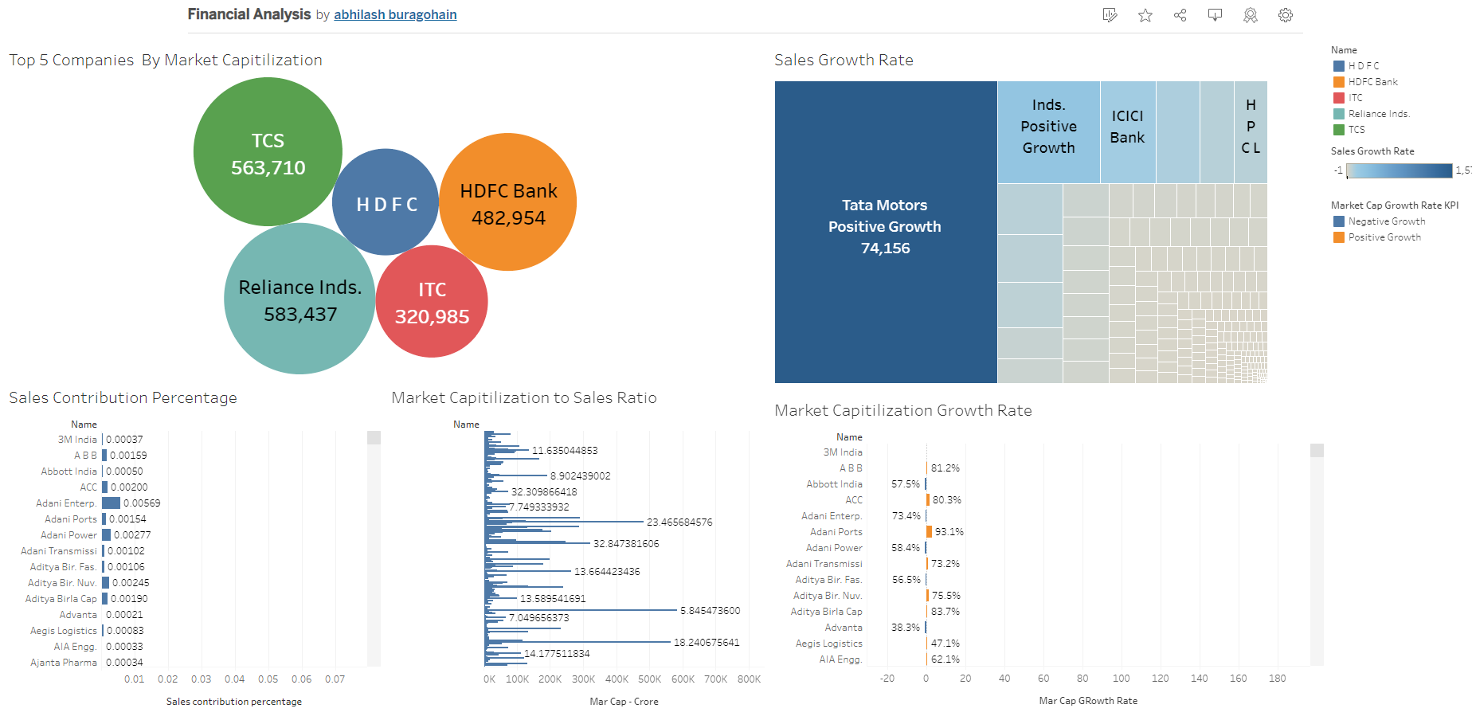
Dashboard

Slide 6
Thank You

